Slide 1
Result of
Season 7 Session 2
Mathematical Problem Solving
The Software Club

Slide 2
Marks
Position | Name | Problem Solving (10) | Code Optimization (6) | Coding Standards (4) | Total (20)
3 | Mallika Bhattarai | 10 | 0 | 1 | 11
3 | Umesh Dhungana | 10 | 0 | 1 | 11
3 | Prayush Shrestha | 10 | 0 | 1 | 11

Slide 3
Marks
Position | Name | Problem Solving (10) | Code Optimization (6) | Coding Standards (4) | Total (20)
2 | Anuska Maharjan | 10 | 0 | 2 | 12
2 | Anil Parajuli | 10 | 0 | 2 | 12
2 | Biplav Shrestha | 10 | 0 | 2 | 12
2 | Suman Maharjan | 10 | 0 | 2 | 12

Slide 4
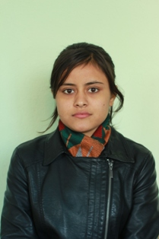
Winner
1st Asmita Bista
Problem Solving(10) | Code Optimization (6) | Coding Standard (4) | Total
10 | 6 | 4 | 20

Slide 5
Question
Given below is the list of marks obtained by a class of 50 students in an annual examination.
  43 65 51 27 79 11 56 61 52 09 25 36 07 49 55 63 74 81 49 37
  40 49 16 75 87 91 33 24 58 78 65 56 76 67 45 54 35 63 12 21
  73 49 51 19 39 49 68 93 85 59
Write a program to count the number of students belonging to each of following groups of marks: 0-9, 10-19, 20-29.....100.

Slide 6
Find codes at
www.github.com/softwareclub

